Slide 1
Convolution Filter, Edge detection

Slide 2
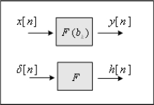
Filtering System
It creates Output according to Input.
System
From an image perspective, Filter is a tool for processing images
Image Filter is an area unit filter (two dimensions) that reflects the values of the surrounding pixels.

Slide 3
Why filtering, edge detection can be together?
Filtering은 noise 제거에 사용
(I.e used to remove noise)
Edge detection은 물체의 경계선 이나 윤곽선을 찾는데 사용.
( I.e used to find the boundary or outline of an object.)
Filtering 과 Edge detection은 모두 이미지 전처리 과정의 방법
(I.e They are both methods of image pre-processing)
Filtering 과 Edge detection 같은 방법으로 적용
(mask와convolution 사용).
(I.e Applied in the same way as filtering and edge detection)

Slide 4
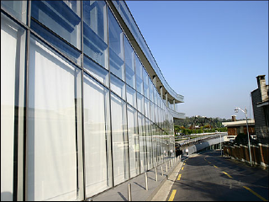
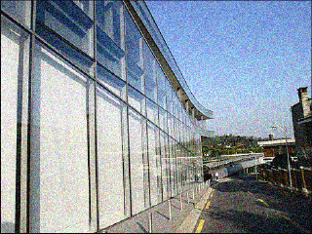
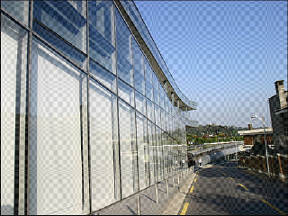
Filtering
What is image noise?
Information not required for actual image information
To remove noise from the image we use Filtering.
Noise Class:
① Uniform noise ② Salt and pepper noise ③ Gaussian noise
Original image
salt and pepper noise
Gaussian noise

Slide 5
Noise removal
Spatial filtering:
Spatial filtering is mainly used to remove noise.
The spatial filtering method is also called mask, filter, template window, and kernel.

Slide 6
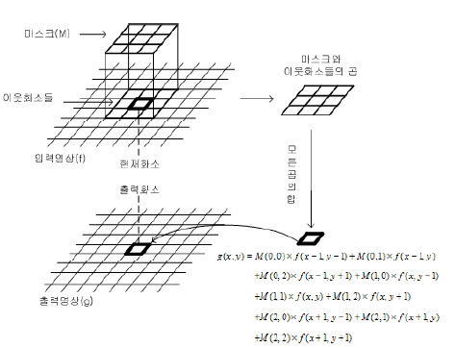
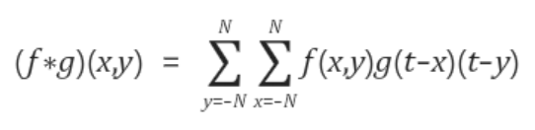
Convolution
where f is the fil ter, * de notes convolu tion, N is the filter size

Slide 7
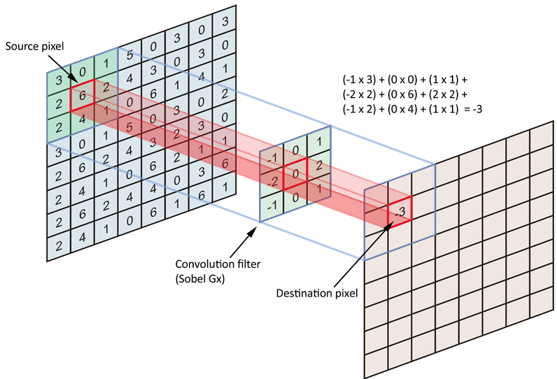

Convolution
Convolution is the process of adding each element of the image to its local neighbors, weighted by the filter.

Slide 8
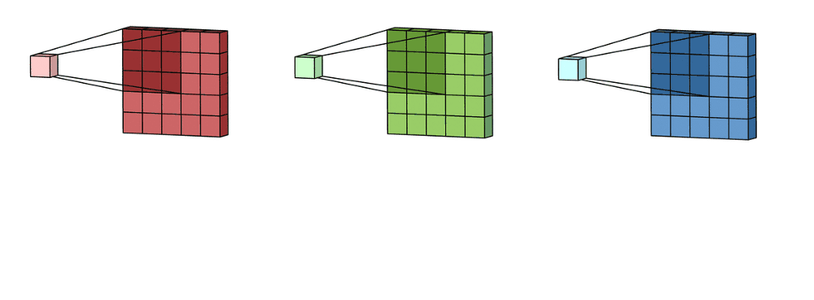
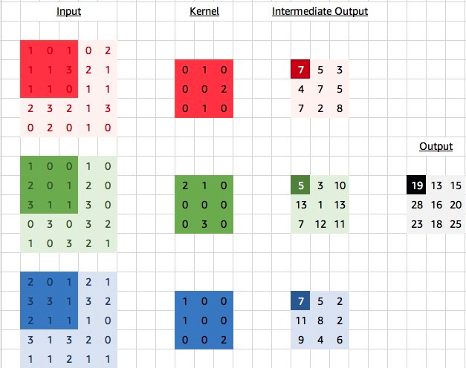
Multi Channel Convolution

Slide 9
Image Filtering
LPF : low pass filtering
Filter that passes through the low frequency range and cuts off the high frequency range
The low-frequency component means that there is little difference in color from the surroundings.
The high-frequency component of the filtered image becomes blurry.
The effect of removing the noise of high-frequency components
HPF : high-pass filtering
Only high-frequency data is passed.
The high-frequency component refers to a part with a large difference in color from the surroundings.
The high-frequency components that have passed through the filter become clearer in the image.
You can get the boundary value.

Slide 10
Image Filtering
Type of filter
Average Filter
Median Filter
Maximum Filter
Minimum Filter
Midpoint Filter
Alpha-trimmed Mean Filter

Slide 11
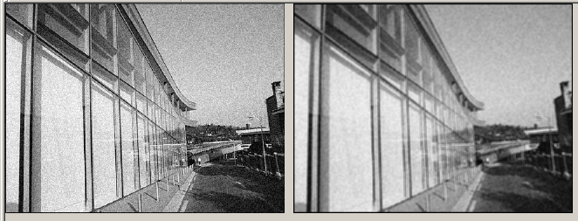
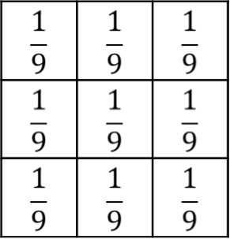
Average Filter(평균 필터)
Take the average value of the mask.
All images are blurred (same as LPF).
Original image
Processing image

Slide 12
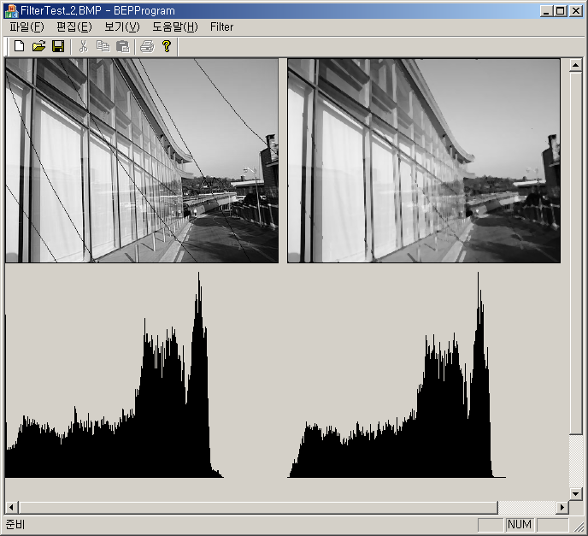
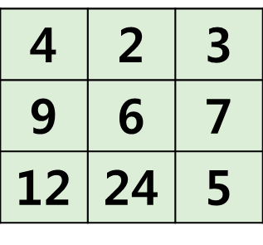
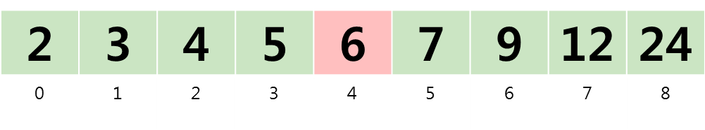
Median Filter(중간값 필터)
Aligns the mask values ​​and applies the median value of the mask to the current value
It retains more details than the average filter.
6 | 5 | 4 | 6 | 7 | 8 | 1
4 | 2 | 3 | 3 | 3 | 7 | 1
9 | 6 | 7 | 2 | 5 | 6 | 2
12 | 24 | 5 | 4 | 4 | 5 | 2
Original image
Processing image
representative value

Slide 13
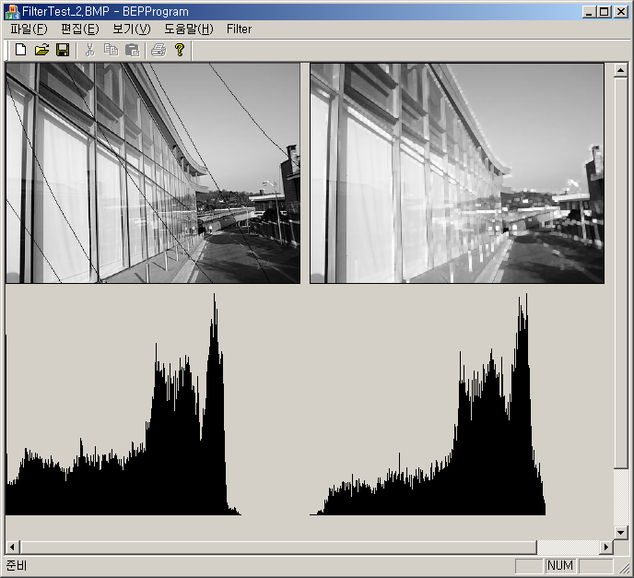
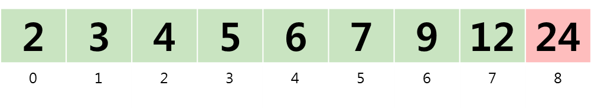
Maximum Filter(최대값 필터)
Sort the mask values ​​to reflect the largest value
3 | 5 | 4 | 6 | 7 | 8 | 1
4 | 2 | 3 | 3 | 3 | 7 | 1
9 | 6 | 7 | 2 | 5 | 6 | 2
12 | 24 | 5 | 4 | 4 | 5 | 2
Original image
Processing image
representative value

Slide 14
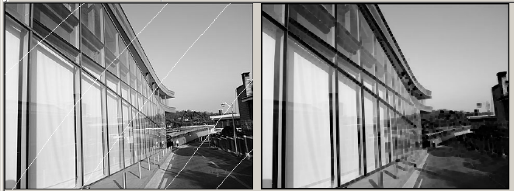
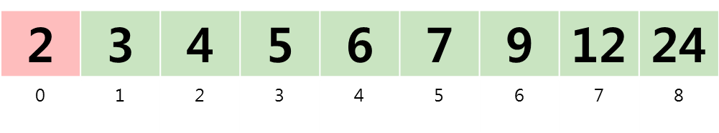
Minimum Filter(최소값 필터)
Sort the mask values ​​to reflect the smallest value.
3 | 5 | 4 | 6 | 7 | 8 | 1
4 | 2 | 3 | 3 | 3 | 7 | 1
9 | 6 | 7 | 2 | 5 | 6 | 2
12 | 24 | 5 | 4 | 4 | 5 | 2
Original image
Processing image
representative value

Slide 15
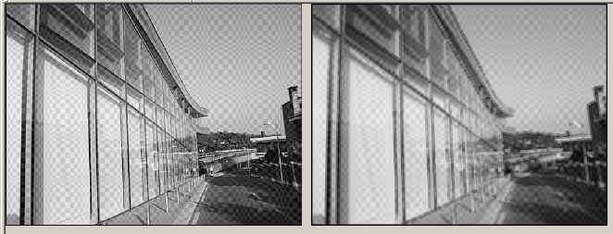
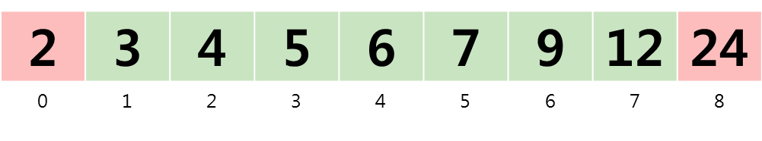
Midpoint Filter
Align the mask values ​​to reflect the average of the maximum and minimum values.
3 | 5 | 4 | 6 | 7 | 8 | 1
4 | 2 | 3 | 3 | 3 | 7 | 1
9 | 6 | 7 | 2 | 5 | 6 | 2
12 | 24 | 5 | 4 | 4 | 5 | 2
Original image
Processing image
representative value
평균

Slide 16

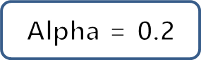
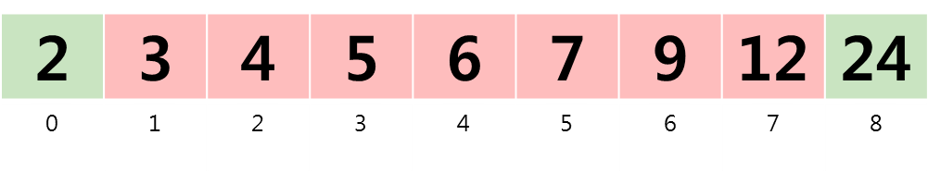
Alpha-trimmed Mean Filter
After sorting the masks, the average is calculated excluding the maximum and minimum values ​​and reflected in the current value changes the number of values ​​to be excluded according to the Alpha.
h | 5 | 4 | 6 | 7 | 8 | 1
4 | 2 | 3 | 3 | 3 | 7 | 1
9 | 6 | 7 | 2 | 5 | 6 | 2
12 | 24 | 5 | 4 | 4 | 5 | 2
Original image
Processing image
representative value
평 균

Slide 17
H/W
Applying various padding methods
Implement all filters
Use Average, Median, Maximum, Minimum, Midpoint, Alpha-trimmed Mean filter on images with real noise.
Apply by varying the size of the mask
Create your own mask and compare the expected output image when ap plied and the result after actual application

Slide 18
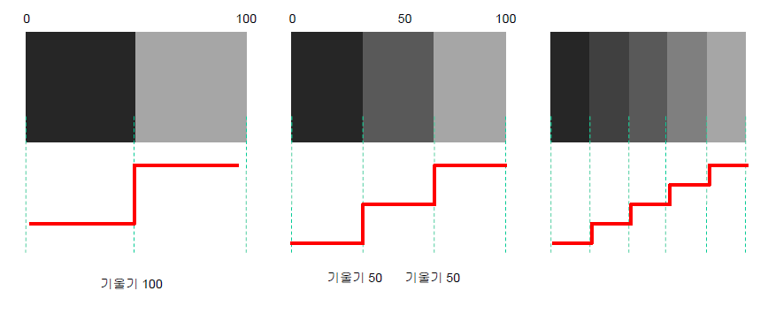
Edge
Gradient : the change of intensity
Gradient 100
Gradient 50
Gradient 50

Slide 19
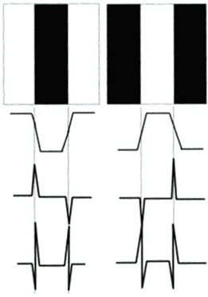
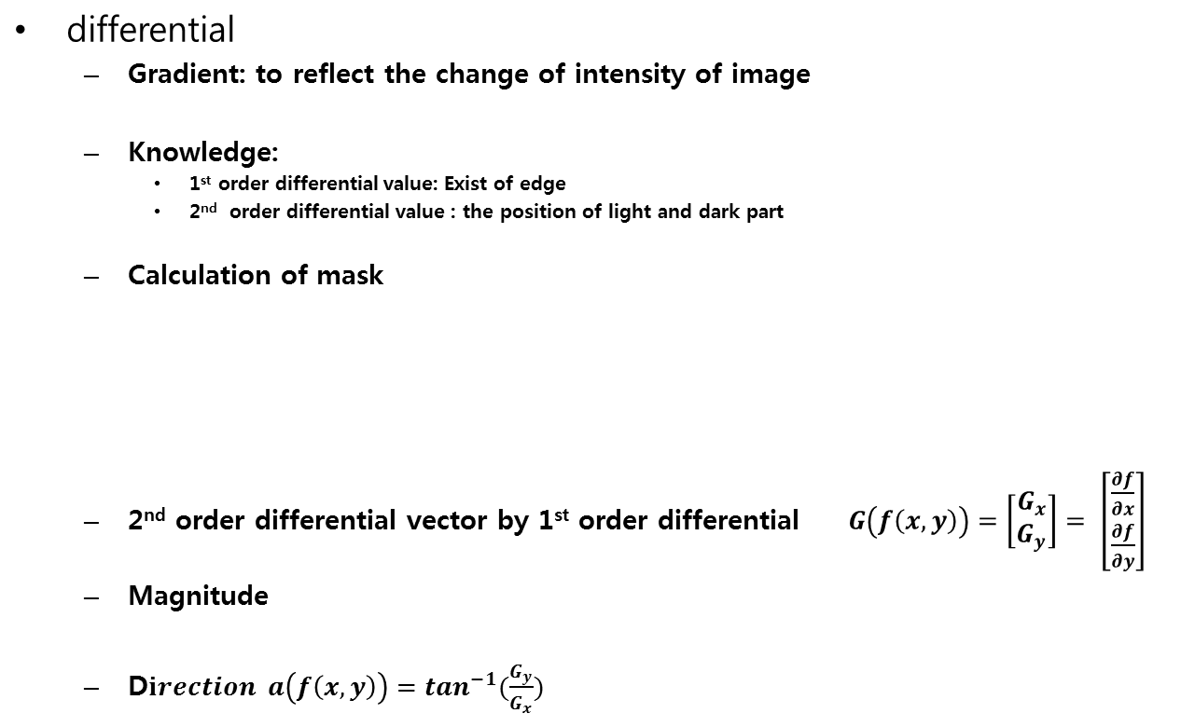
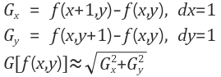
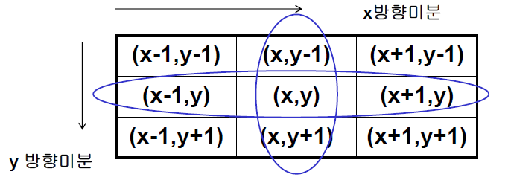
Edge detection
Edge image
Signal of edge
1st order differential
2nd order differential

Slide 20
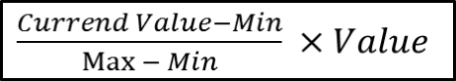
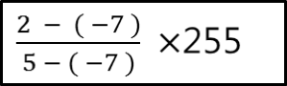
Normalize
Used to set a range of values.
(Intensity value is 0~255)
Ex)
-7
2
5
0
?
255

Slide 21
Edge Detection
Sobel
Prewitt
Roberts
Laplacian
Highboost-spatial
LoG
DoG
Orientation

Slide 22
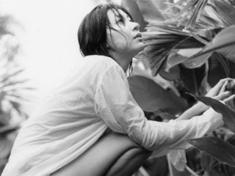
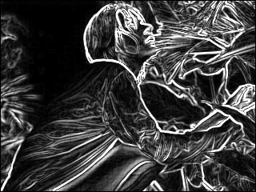
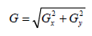
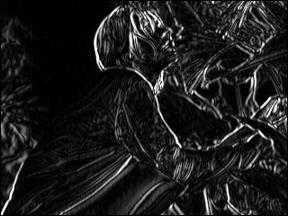
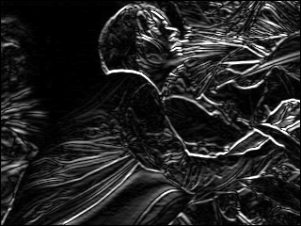
Sobel
x+y axis :
Original image
x+y axis edge detection
Sensitive to diagonal direction
-1
0
1
-1
-2
-1
-2
0
2
0
0
0
-1
0
1
1
2
1
x axis Sobel mask
y axis Sobel mask
X axis edge detection
y axis edge detection

Slide 23
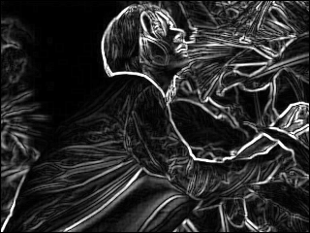

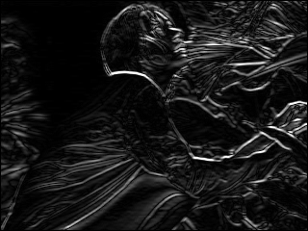
Prewitt
Same as Sobel
Sensitive to vertical and horizontal edges
-1
0
1
-1
-1
-1
Original image
x+y axis edge detection
-1
0
1
0
0
0
-1
0
1
1
1
1
x axis prewitt mask
y axis prewitt mask
x axis edge detection
y axis edge detection

Slide 24
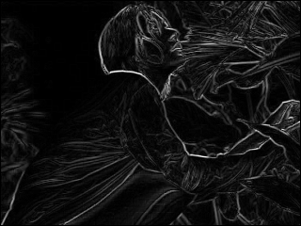
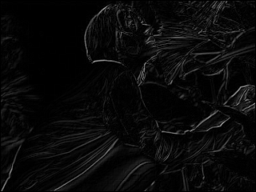
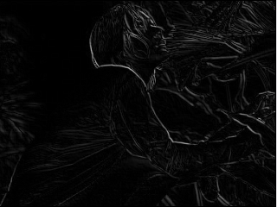
Roberts
Faster than the Sobel Prewitt method.
Smaller than other masks, fewer operations and sensitive to noise
Original image
-1
0
0
0
0
-1
0
1
0
0
1
0
0
0
0
0
0
0
Upper right to lower left edge detection
Upper right to lower left Roberts mask
Upper left to lower right
Roberts mask
Upper left to lower right edge detection

Slide 25
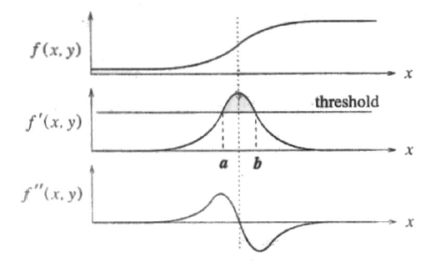
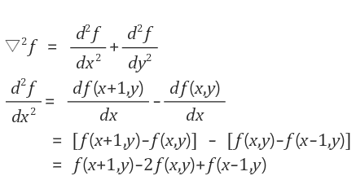
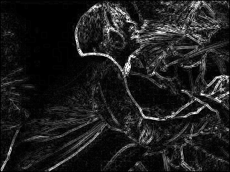
Edge detection
Sobel
Prewitt
Roberts
2 Differential method
Laplacian
Gaussian
LOG
DOG
Etc.
Highboost-spatial
Orientation
1
1
1
0
1
0
1
-8
1
1
-4
1
1
1
1
0
1
0
Only using one mask so the speed is quick
2nd order differential
All direction edge can be detected
The edge is not smooth

Slide 26
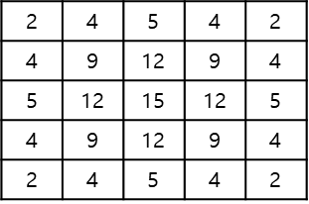
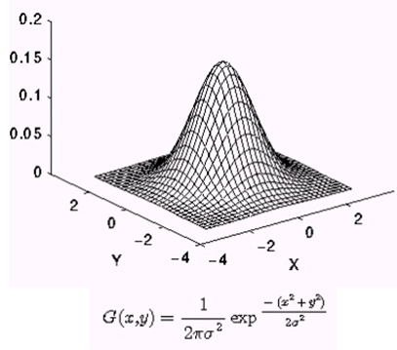
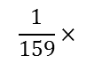
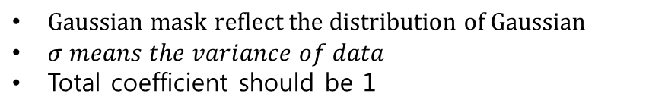
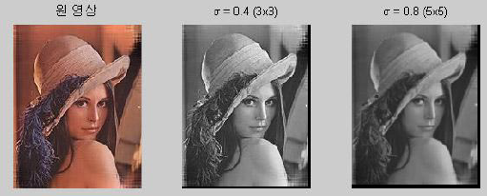
Edge detection
Sobel
Prewitt
Roberts
2 Differential method
Laplacian
Gaussian
LOG
DOG
Etc.
Highboost-spatial
Orientation

Slide 27
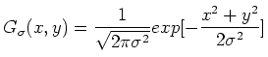
Gaussian Mask
Edge detection
Sobel
Prewitt
Roberts
2 Differential method
Laplacian
Gaussian
LOG
DOG
Etc.
Highboost-spatial
Orientation
2
4
5
4
2
4
9
12
9
4
5
12
15
12
5
4
9
12
9
4
2
4
5
4
2

Slide 28
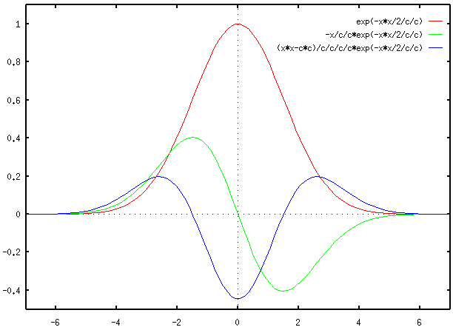
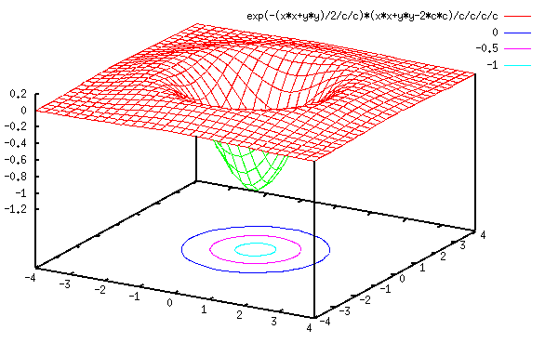

LoG
Laplacian of Gaussian (LoG)
Gaussian's Laplacian Operation

Slide 29




DoG

Slide 30


Highboost-spatial
Original image
Highpass image
Highboost image

